Slide 1
Installation Guide to Model-Based Design Toolbox S32K3xx Series
McMaster Automotive Resource Centre (MARC)
Notes:
HVBMS NXP Tutorials can be found for download from: https://mcmasteru365.sharepoint.com/:u:/r/sites/BatteryWorkforceChallenge-StudentsandManagers-SW2BMSSoftware/Shared%20Documents/SW2%20BMS%20Software/Resources/Archived%20Tutorials/Setting%20Up%20NXP/Tutorial%20-%20HVBMS%20NXP%201.zip?csf=1&web=1&e=RvlWkP This presentation is completed based on “Step 1 - Model_Based_Design_Toolbox_S32K3xx_Series_Quick_Start_Guide.pdf” file, which can be found from Tutorial - HVBMS NXP 1 > S32K - Model Based Design ToolBox after downloading the above .zip file.

Slide 2
Installation Guide to Model-Based Design Toolbox S32K3xx Series
System Requirements
Criteria | Minimum Requirements
Operating Systems | Windows® x64 processor
RAM | 4 GB
Disk | 6 GB
Web Downloads | Internet
Operating System Supported
 | SP Level | 64-bit
Windows 7 | SP1 | x
Windows 10 |  | x

Slide 3
Installation Guide to Model-Based Design Toolbox S32K3xx Series
MathWorks Product Requirements
Product Name | Version
Simulink | R2020a or later
Embedded Coder | R2020a or later
MATLAB Coder | R2020a or later
Simulink Coder | R2020a or later
Stateflow | R2020a or later

Slide 4
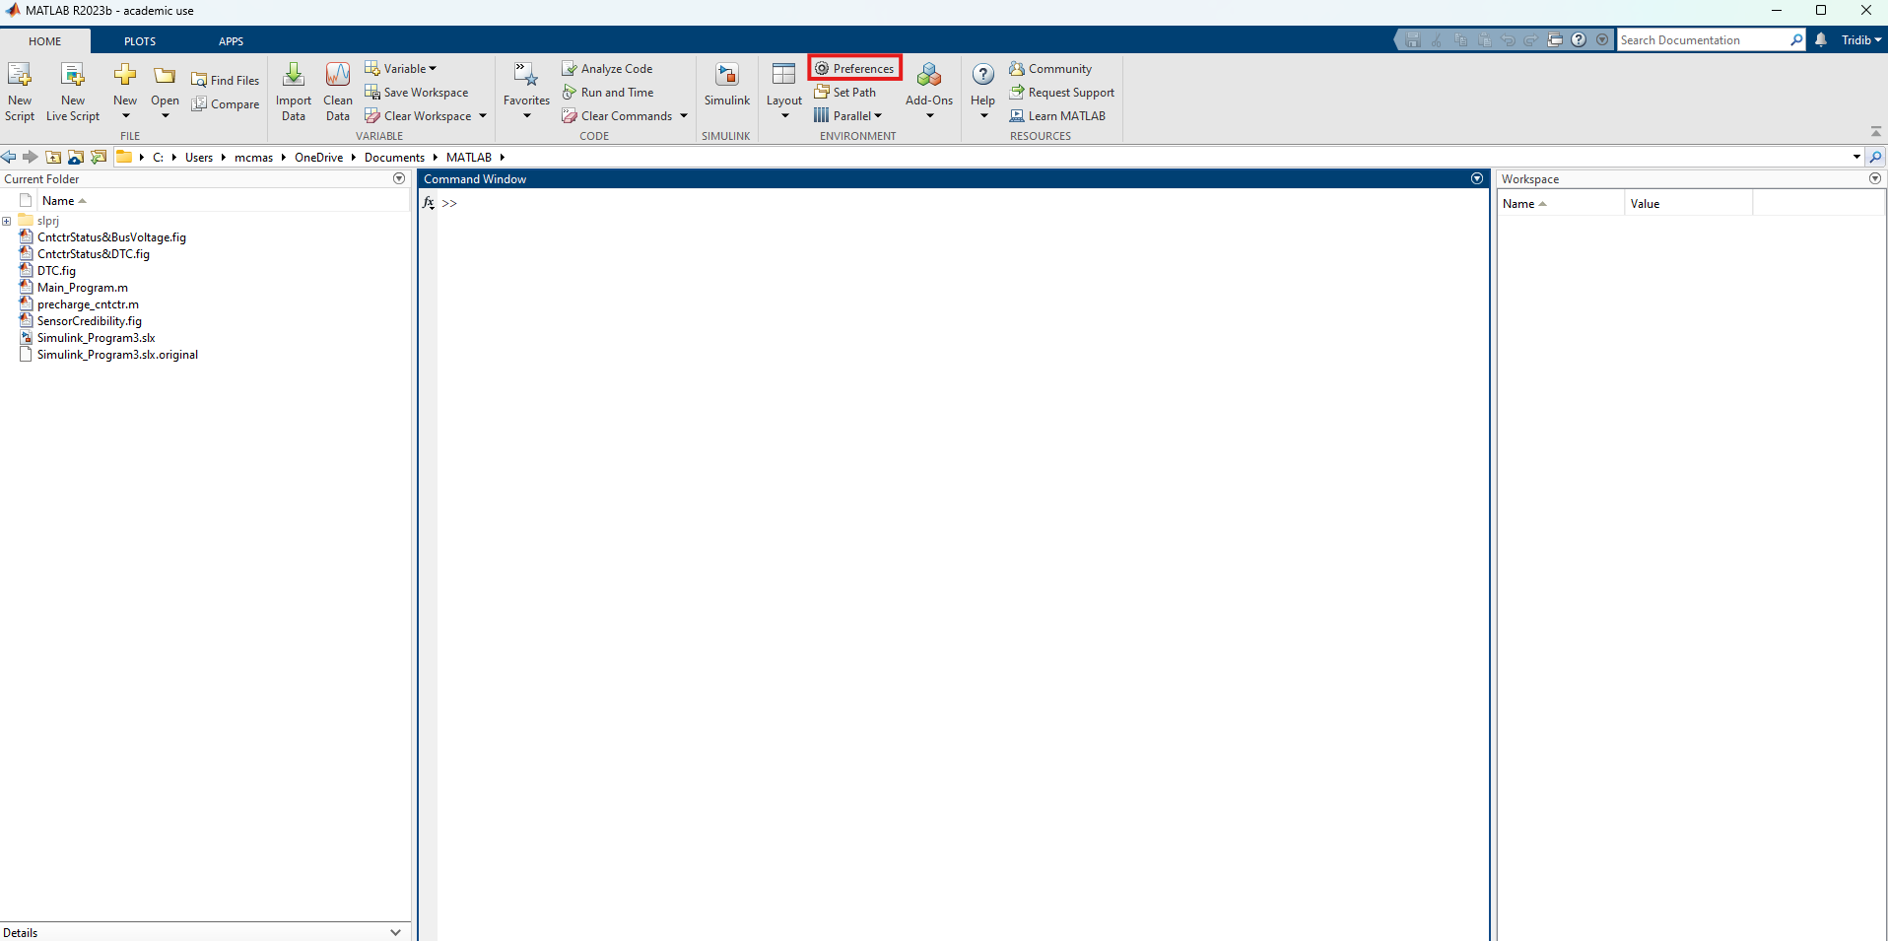
Installation Guide to Model-Based Design Toolbox S32K3xx Series
Installation Steps: NXP Support Package S32K3xx (Version 1.4.0)
1. First, take a note of where the MathWorks Add-ons are installed by default on your computer. To do that, press Preferences from the Home tab of the MATLAB homepage.

Slide 5
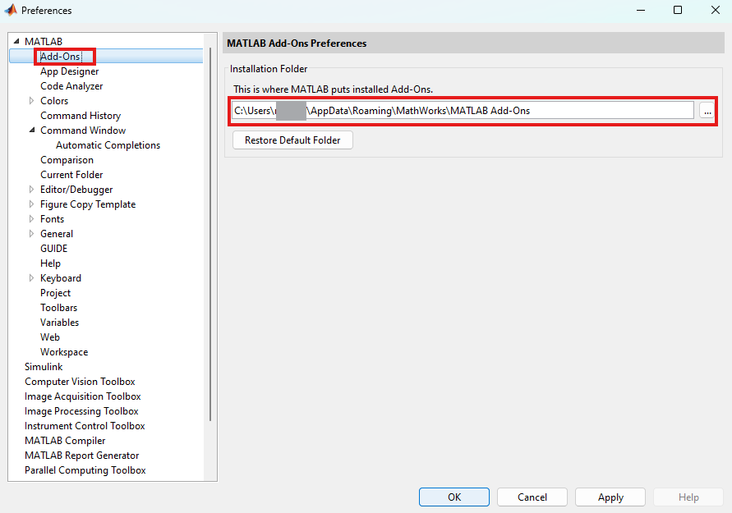
Installation Guide to Model-Based Design Toolbox S32K3xx Series
Installation Steps : NXP Support Package S32K3xx (Version 1.4.0)
2. In the pop-up window, press Add-Ons from MATLAB drop-down. Take a note of the full path of where MATLAB puts installed Add-Ons.
Note: It is recommended to install the MATLAB and NXP Toolbox into a location that does not contains special characters, empty spaces, or mapped drives.

Slide 6
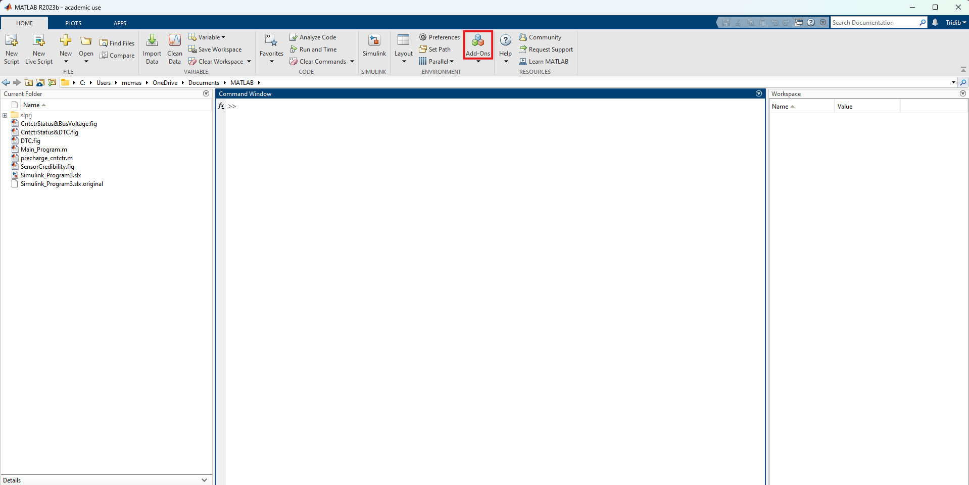
Installation Guide to Model-Based Design Toolbox S32K3xx Series
Installation Steps : NXP Support Package S32K3xx (Version 1.4.0)
3. To install, first press Add-Ons from Home tab.

Slide 7
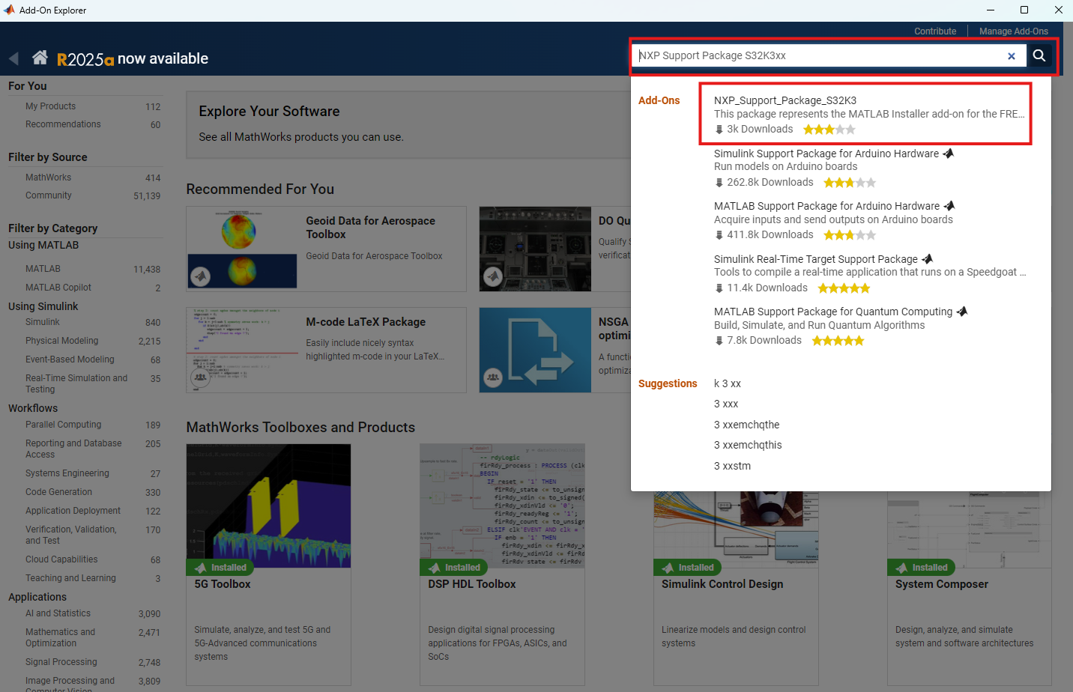
Installation Guide to Model-Based Design Toolbox S32K3xx Series
Installation Steps : NXP Support Package S32K3xx (Version 1.4.0)
4. Search for "NXP Support Package S32K3xx" and press the first search result.

Slide 8
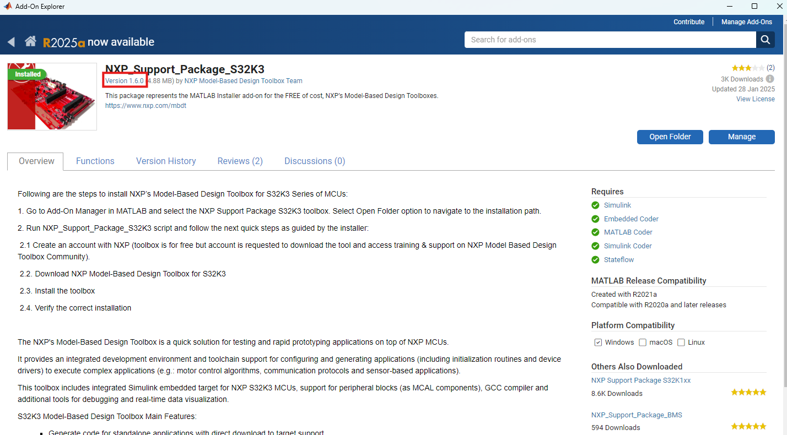
Installation Guide to Model-Based Design Toolbox S32K3xx Series
Installation Steps : NXP Support Package S32K3xx (Version 1.4.0)
5. If you want to install a different version, click on the link Version x.x.x

Slide 9
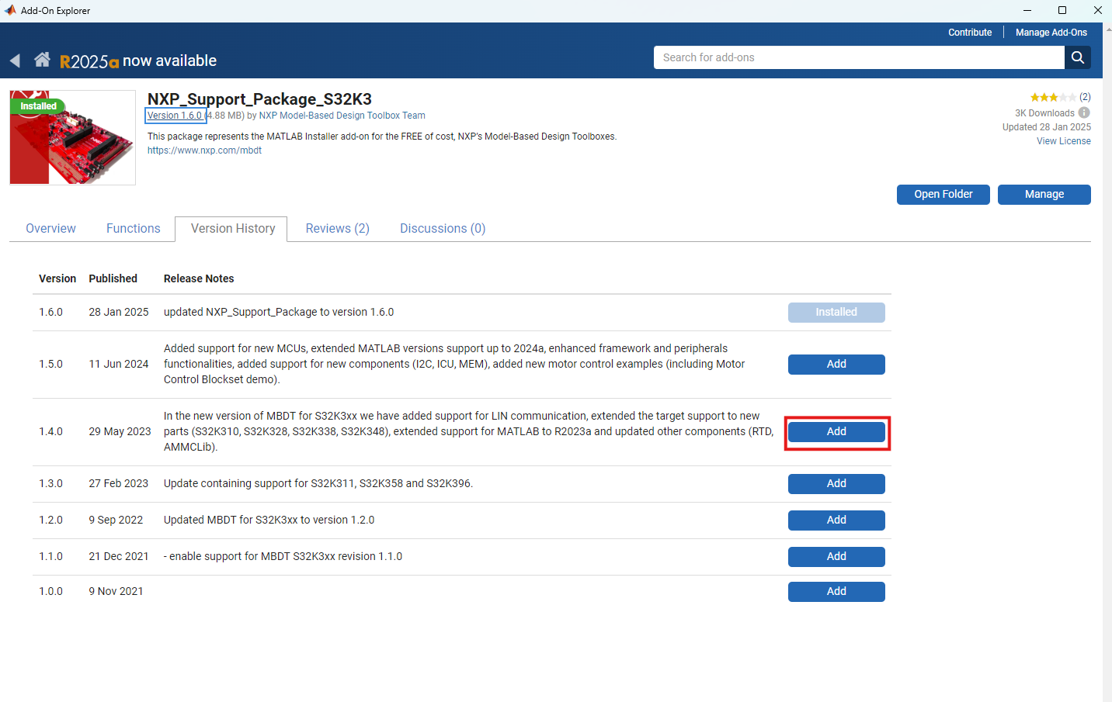
Installation Guide to Model-Based Design Toolbox S32K3xx Series
Installation Steps : NXP Support Package S32K3xx (Version 1.4.0)
6. From this new page, you can choose a different version by pressing Add. For example, to install version 1.4.0, press the corresponding Add button.

Slide 10
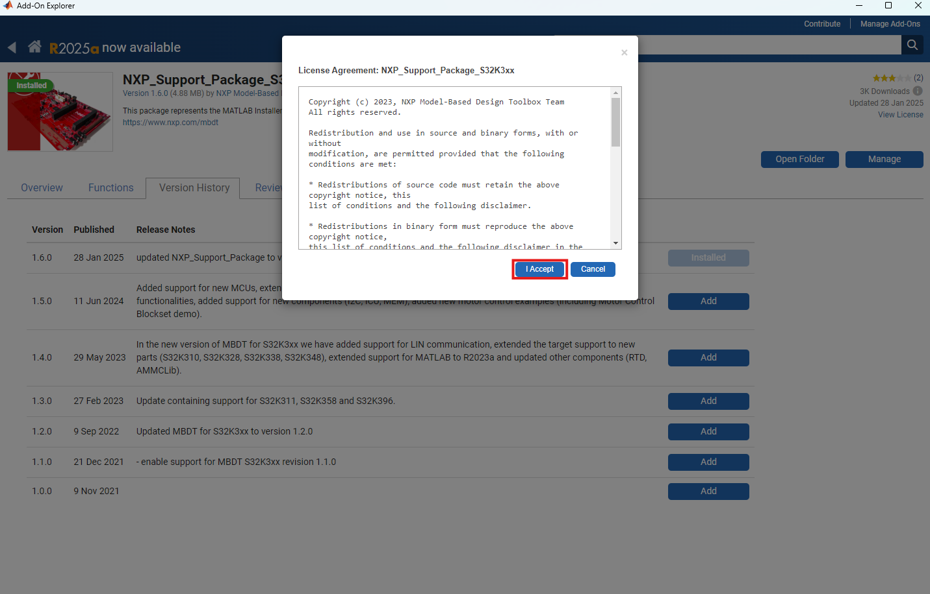
Installation Guide to Model-Based Design Toolbox S32K3xx Series
Installation Steps : NXP Support Package S32K3xx (Version 1.4.0)
7. Read the License Agreement and press I Accept.

Slide 11
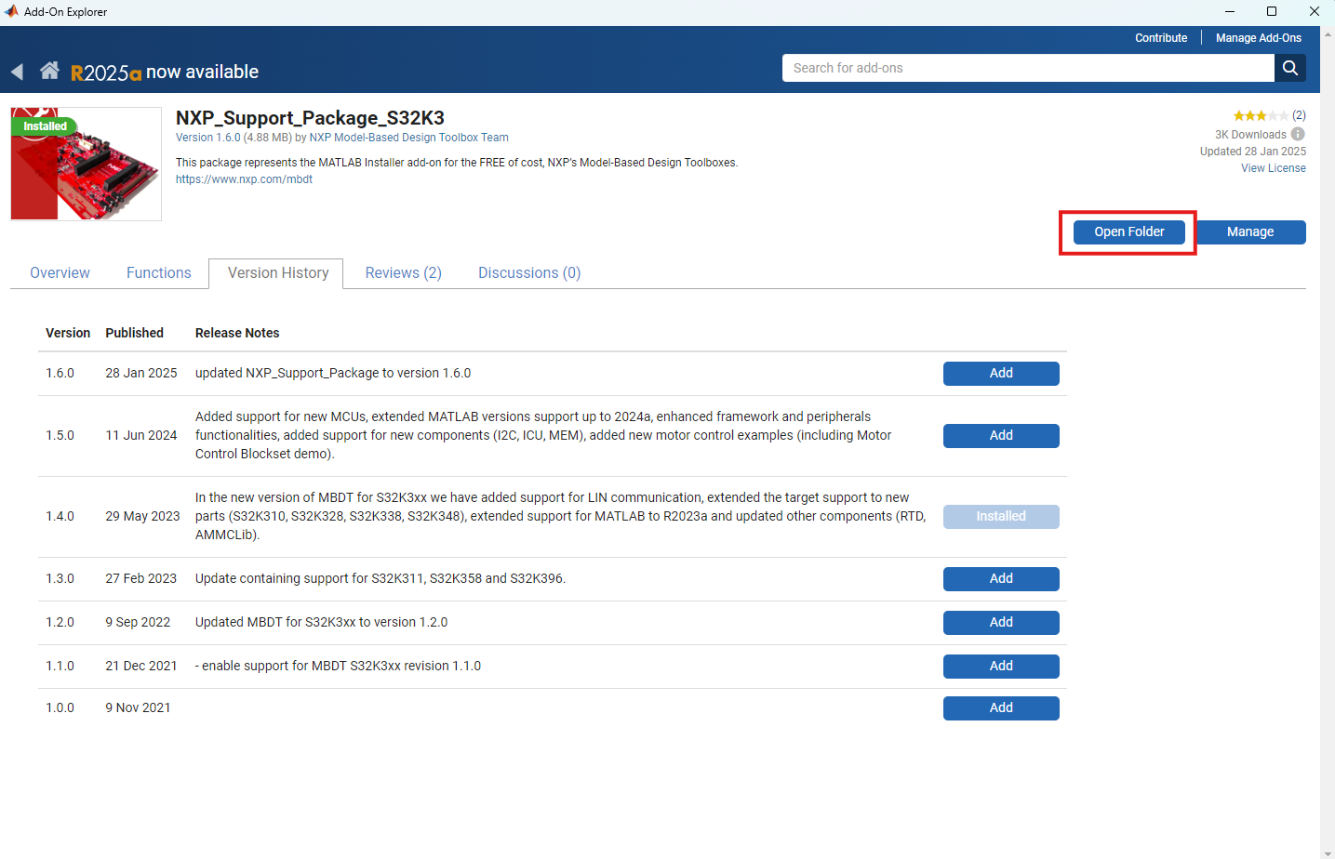
Installation Guide to Model-Based Design Toolbox S32K3xx Series
Installation Steps : NXP Support Package S32K3xx (Version 1.4.0)
8. Once the process is successful, press the Open Folder button.

Slide 12
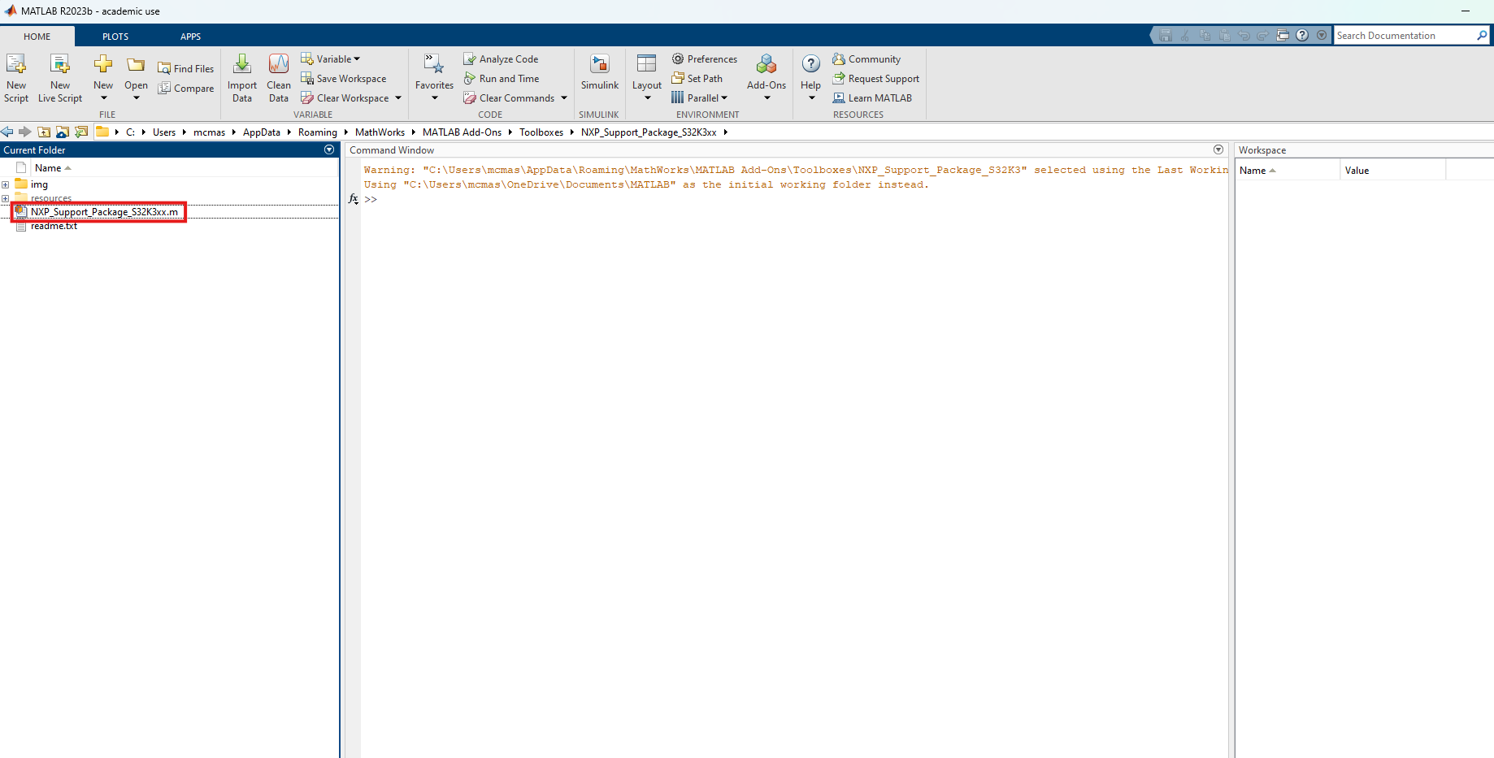
Installation Guide to Model-Based Design Toolbox S32K3xx Series
Installation Steps : NXP Support Package S32K3xx (Version 1.4.0)
9. Open the NXP_Support_Package_S32K3xx.m script by double-clicking it.

Slide 13
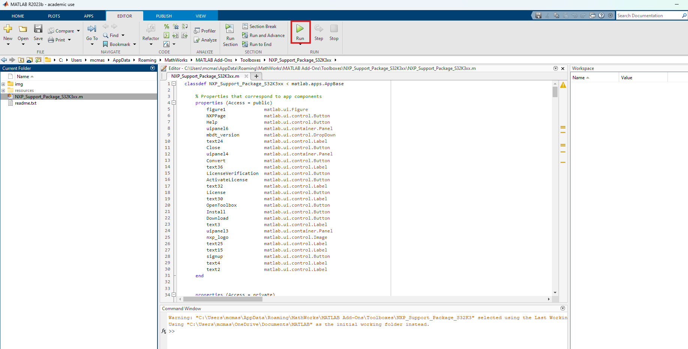
Installation Guide to Model-Based Design Toolbox S32K3xx Series
Installation Steps : NXP Support Package S32K3xx (Version 1.4.0)
10. Run the script by pressing the Run button. It will start the NXP Support Package for S32K3xx.

Slide 14
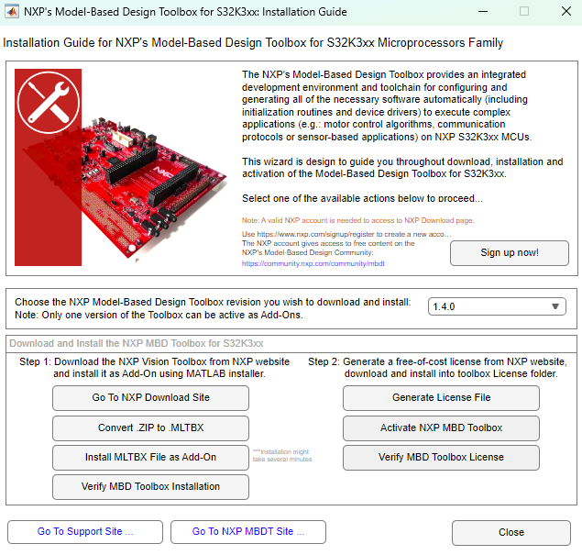
Installation Guide to Model-Based Design Toolbox S32K3xx Series
Installation Steps : NXP Model-Based Design Toolbox for S32K3xx (version 1.4.0)
11. A new pop-up window will appear. NXP Support Package for S32K3xx is a graphical user interface guide that helps to download and install the Model-Based Design Toolbox, and also generate and install the free-of-cost license from NXP website.

Slide 15
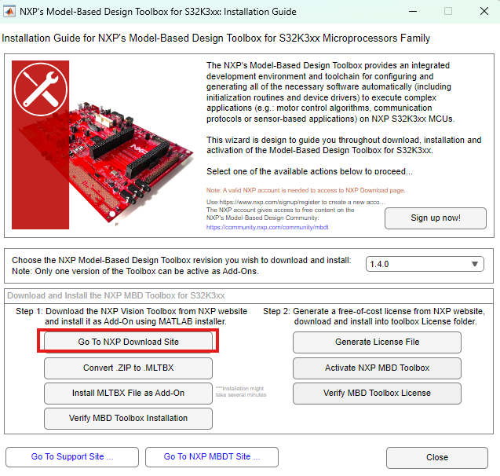
Installation Guide to Model-Based Design Toolbox S32K3xx Series
Installation Steps : NXP Model-Based Design Toolbox for S32K3xx (version 1.4.0)
12. Press Go to NXP Download Site Button.

Slide 16
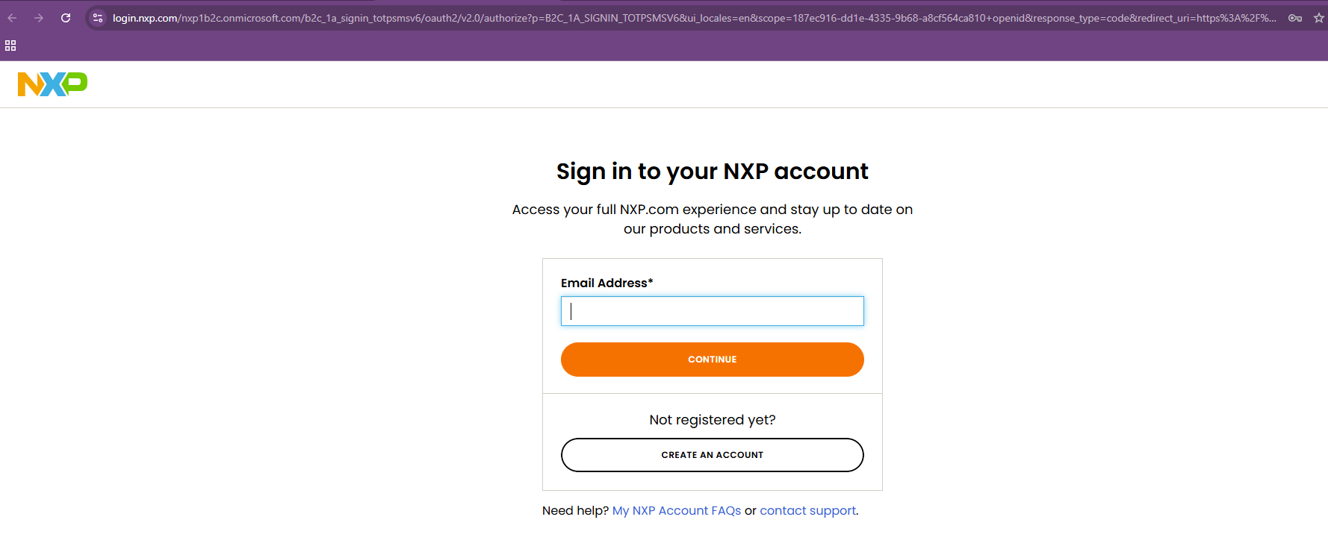
Installation Guide to Model-Based Design Toolbox S32K3xx Series
Installation Steps : NXP Model-Based Design Toolbox for S32K3xx (version 1.4.0)
13. Sign in to NXP. If you already have no account with NXP, create one.

Slide 17
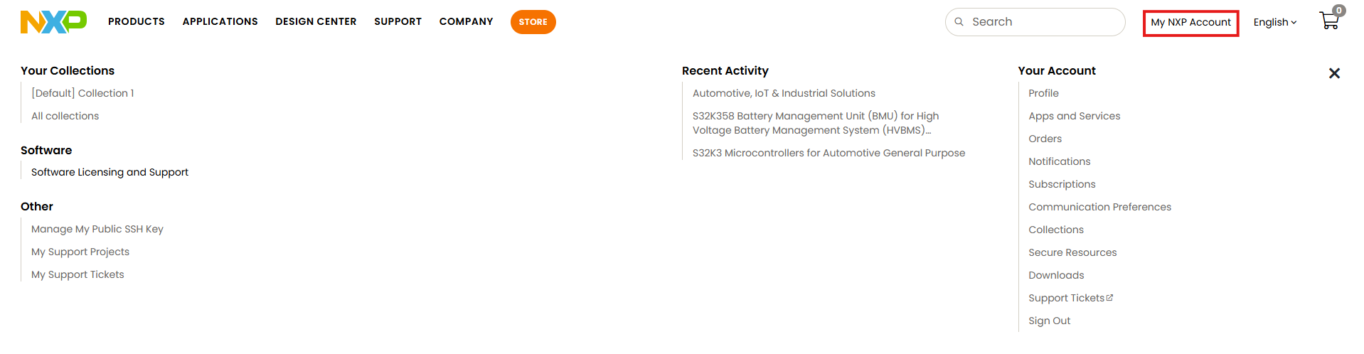
Installation Guide to Model-Based Design Toolbox S32K3xx Series
Installation Steps : NXP Model-Based Design Toolbox for S32K3xx (version 1.4.0)
14. After signing in, the landing page will likely be your profile page. Click on My NXP Account from top right.

Slide 18
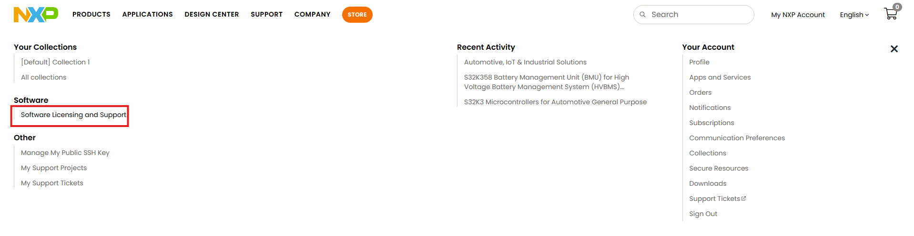
Installation Guide to Model-Based Design Toolbox S32K3xx Series
Installation Steps : NXP Model-Based Design Toolbox for S32K3xx (version 1.4.0)
15. Next, click on Software Licensing and Support.

Slide 19
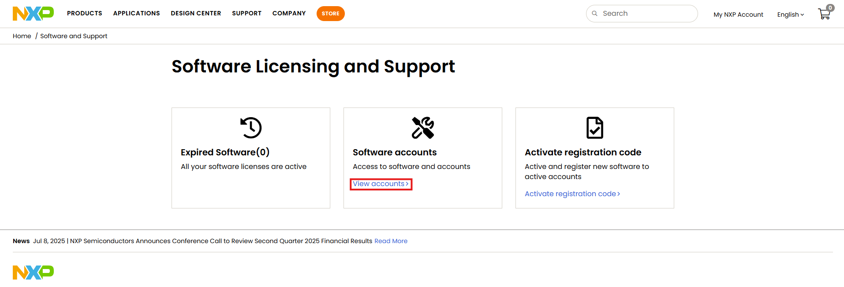
Installation Guide to Model-Based Design Toolbox S32K3xx Series
Installation Steps : NXP Model-Based Design Toolbox for S32K3xx (version 1.4.0)
16. In the new page, click on View accounts.

Slide 20
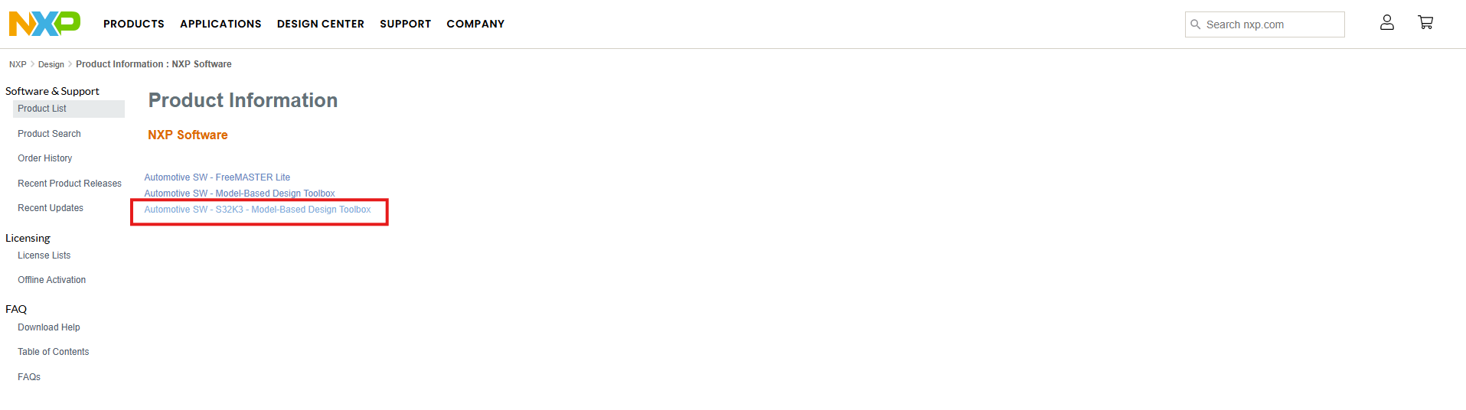
Installation Guide to Model-Based Design Toolbox S32K3xx Series
Installation Steps : NXP Model-Based Design Toolbox for S32K3xx (version 1.4.0)
17. Click on Automotive SW - S32K3 - Model-Based Design Toolbox.

Slide 21
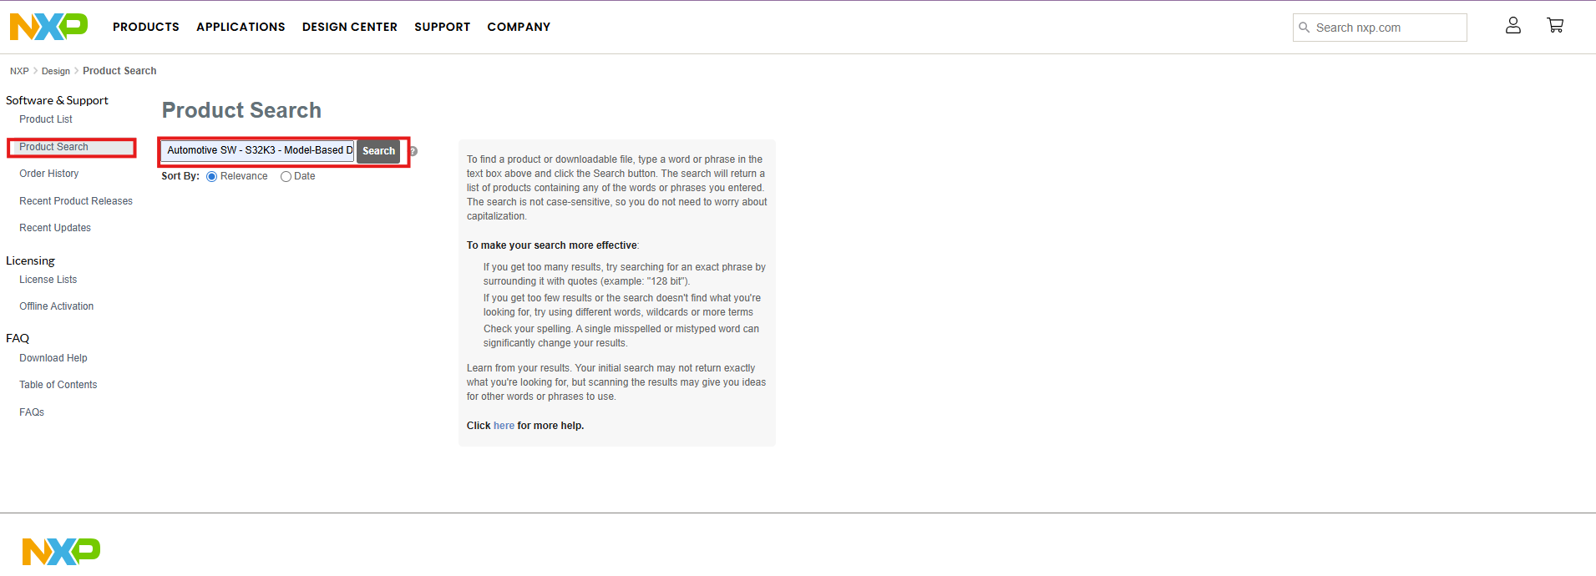
Installation Guide to Model-Based Design Toolbox S32K3xx Series
Installation Steps : NXP Model-Based Design Toolbox for S32K3xx (version 1.4.0)
18. Alternatively, you can search for it from Product Search.

Slide 22
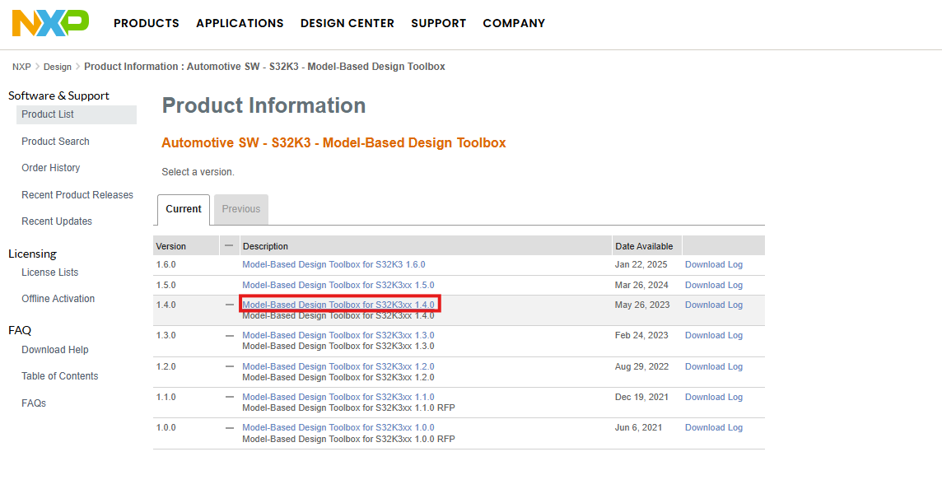
Installation Guide to Model-Based Design Toolbox S32K3xx Series
Installation Steps : NXP Model-Based Design Toolbox for S32K3xx (version 1.4.0)
19. Choose the corresponding version. Since the previously downoaded NXP Support Package S32K3xx was version 1.4.0, NXP Model-Based Design Toolbox for S32K3xx should be 1.4.0.

Slide 23
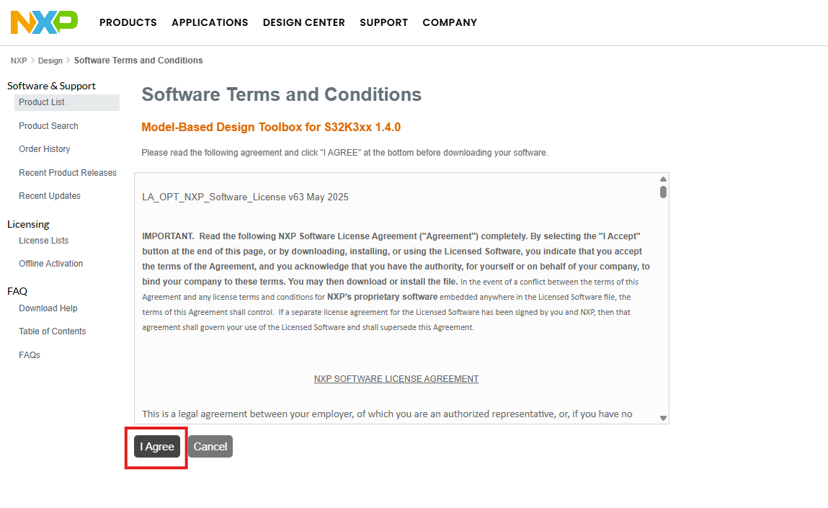
Installation Guide to Model-Based Design Toolbox S32K3xx Series
Installation Steps : NXP Model-Based Design Toolbox for S32K3xx (version 1.4.0)
20. Press I Agree.

Slide 24
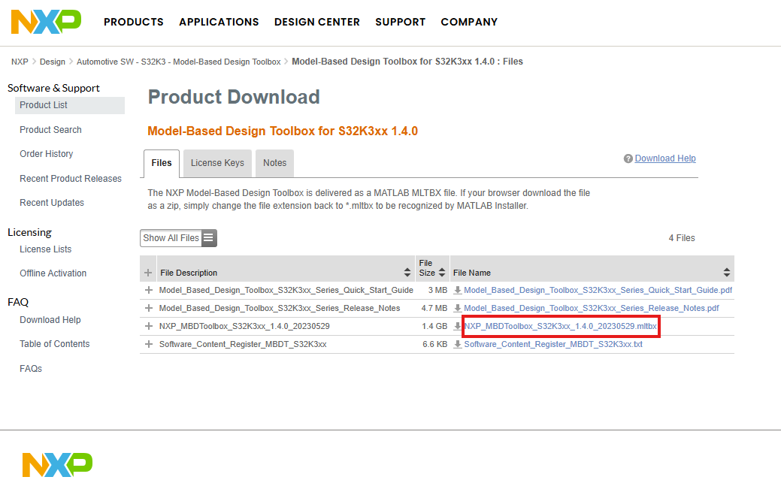
Installation Guide to Model-Based Design Toolbox S32K3xx Series
Installation Steps : NXP Model-Based Design Toolbox for S32K3xx (version 1.4.0)
21. Download the MBDToolbox_S32K3xx_x.x.x_yyyymmdd.mltbx file.

Slide 25
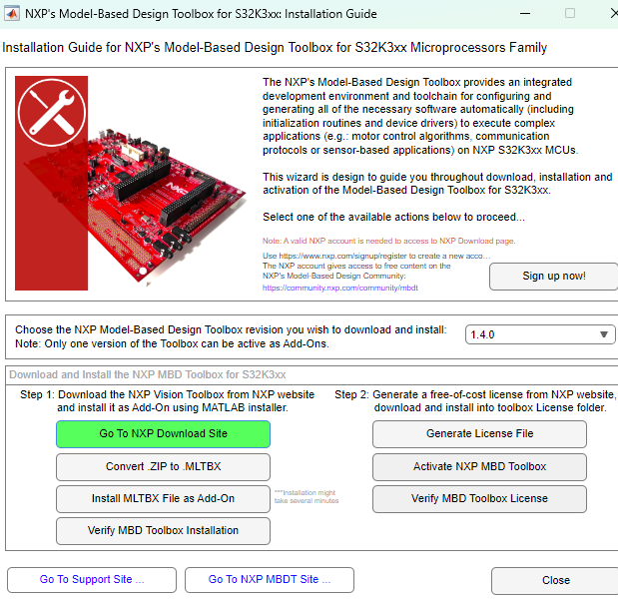
Installation Guide to Model-Based Design Toolbox S32K3xx Series
Installation Steps : NXP Model-Based Design Toolbox for S32K3xx (version 1.4.0)
22. Go back to NXP Support Package for S32K3xx and press the Convert .ZIP to .MLTBX button.

Slide 26
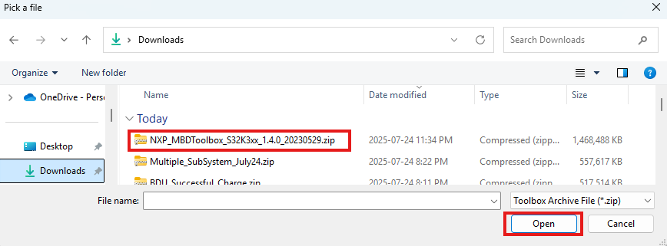
Installation Guide to Model-Based Design Toolbox S32K3xx Series
Installation Steps : NXP Model-Based Design Toolbox for S32K3xx (version 1.4.0)
23. In the newly opened Browsing window, select the file downloaded and press Open.

Slide 27
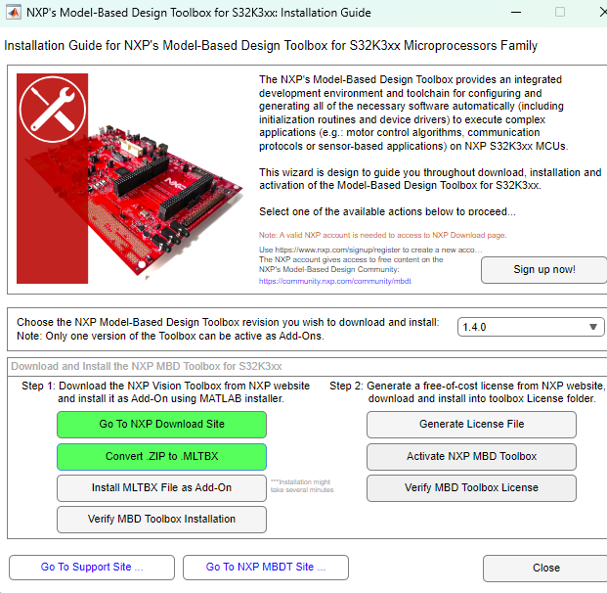
Installation Guide to Model-Based Design Toolbox S32K3xx Series
Installation Steps : NXP Model-Based Design Toolbox for S32K3xx (version 1.4.0)
24. Go back to NXP Support Package for S32K3xx and select the Install MLTBX File as Add-On button.

Slide 28
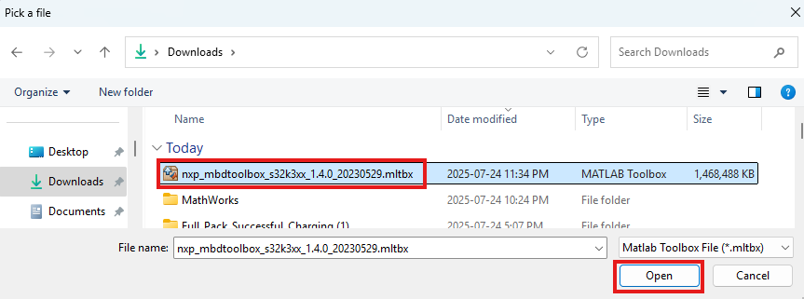
Installation Guide to Model-Based Design Toolbox S32K3xx Series
Installation Steps : NXP Model-Based Design Toolbox for S32K3xx (version 1.4.0)
25. In the newly opened window, browse for the MLTBX file and press Open.

Slide 29
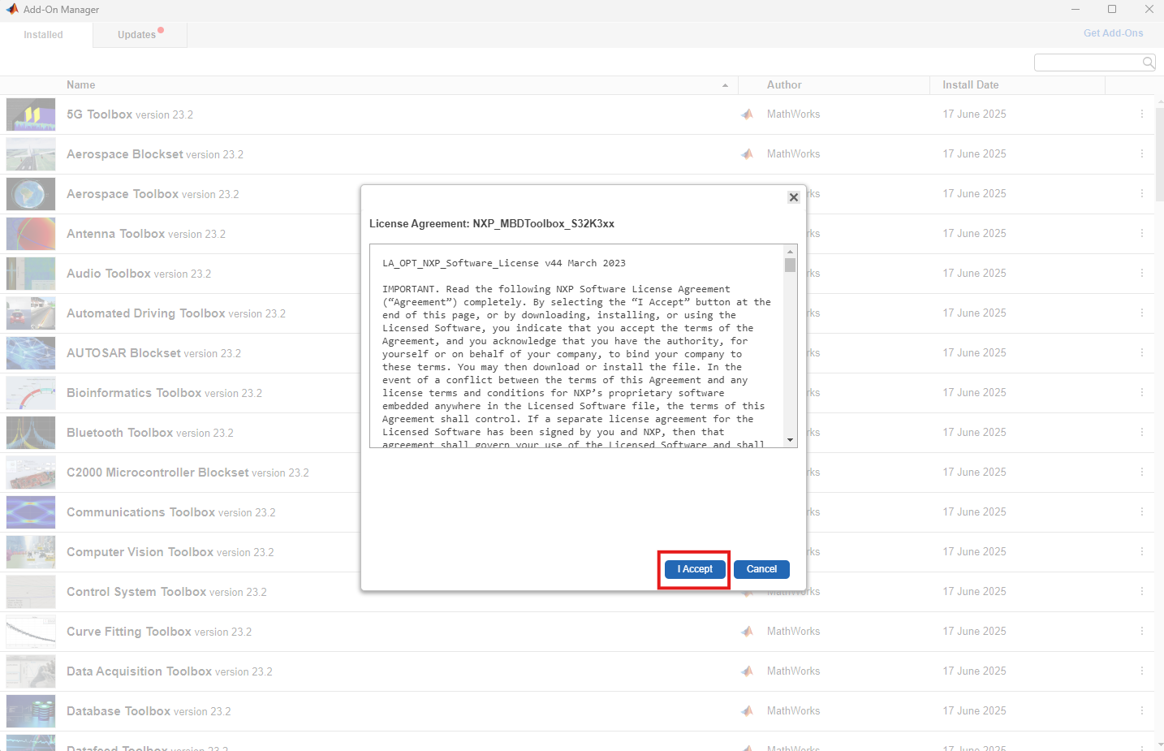
Installation Guide to Model-Based Design Toolbox S32K3xx Series
Installation Steps : NXP Model-Based Design Toolbox for S32K3xx (version 1.4.0)
26. In the MATLAB Add-On Manager, Review the Terms and Conditions as you scroll down, and press I Accept Button. This action starts MBDT for S32K3xx Toolbox installation process.
Note: Installation might take several minutes

Slide 30
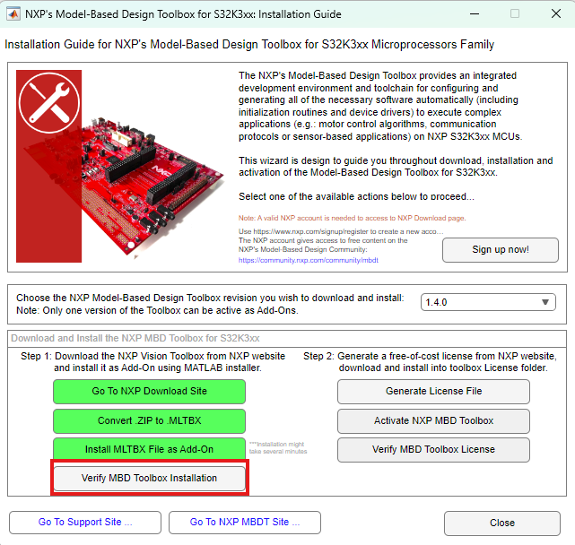
Installation Guide to Model-Based Design Toolbox S32K3xx Series
Installation Steps : NXP Model-Based Design Toolbox for S32K3xx (version 1.4.0)
27. Once the installation is complete, go back to NXP Support Package for S32K3xx and press the Verify MBD Toolbox Installation button.

Slide 31
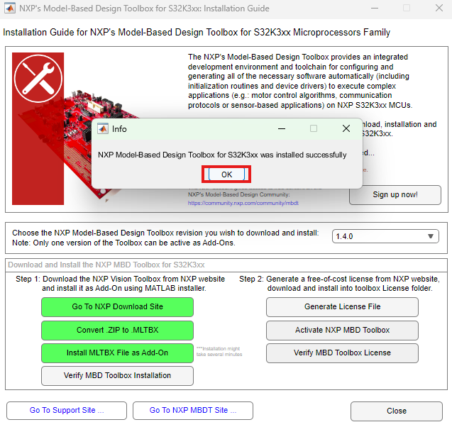
Installation Guide to Model-Based Design Toolbox S32K3xx Series
Installation Steps : NXP Model-Based Design Toolbox for S32K3xx (version 1.4.0)
28. In the pop-up window, press OK.

Slide 32
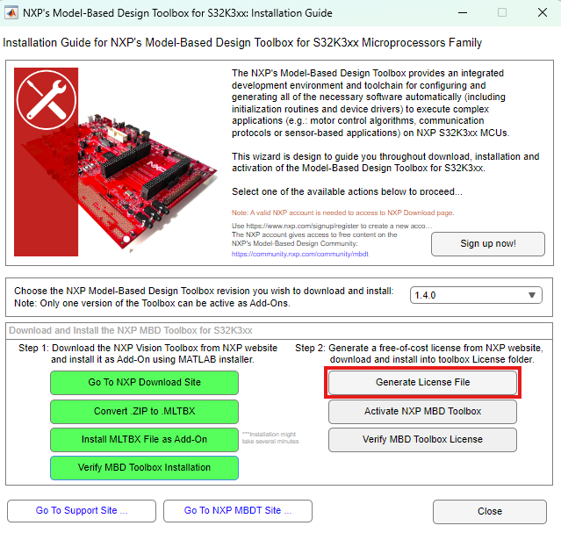
Installation Guide to Model-Based Design Toolbox S32K3xx Series
Installation Steps : Generate and Activate NXP MBDT for S32K3xx license
29. Even the MBDT for S32K3xx is free-of-charge, users still need to generate and install a free license. The following steps guides you on how to achieve such license. First, press the Generate License File button in the NXP Support Package for S32K3xx.

Slide 33
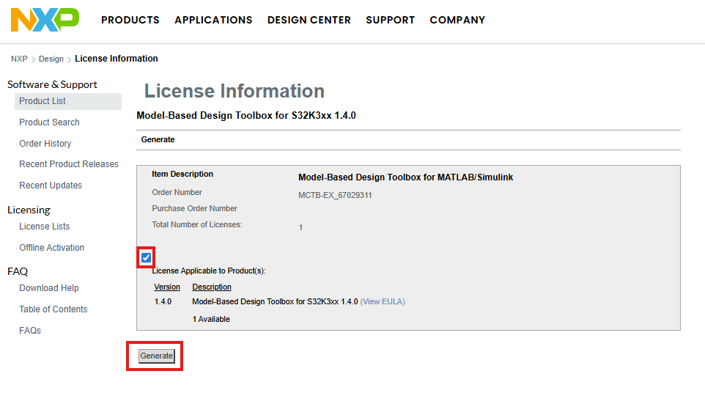
Installation Guide to Model-Based Design Toolbox S32K3xx Series
Installation Steps : Generate and Activate NXP MBDT for S32K3xx license
30. In the newly opened webpage, select the checkbox as shown below, and press the generate button.
Note: If this page does not show up, you have to go to My NXP Account > Software Licensing and Support > View accounts > Automotive SW - S32K3 - Model-Based Design Toolbox as shown in previous steps a few slides ago.

Slide 34
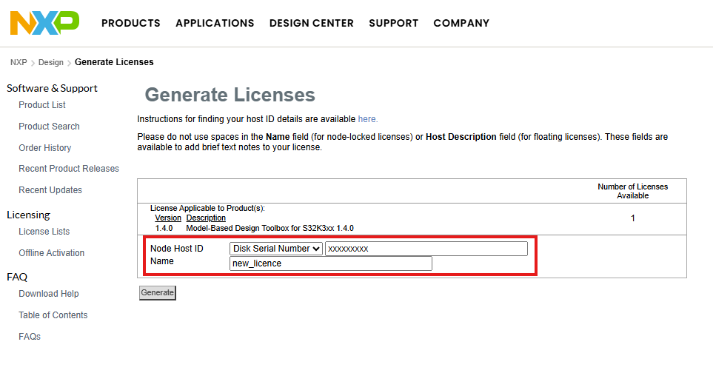
Installation Guide to Model-Based Design Toolbox S32K3xx Series
Installation Steps : Generate and Activate NXP MBDT for S32K3xx license
31. Select Disk Serial Number, and type the host id number. Give a name to the license, and press the Generate button. To find the host ID, follow the next step.

Slide 35
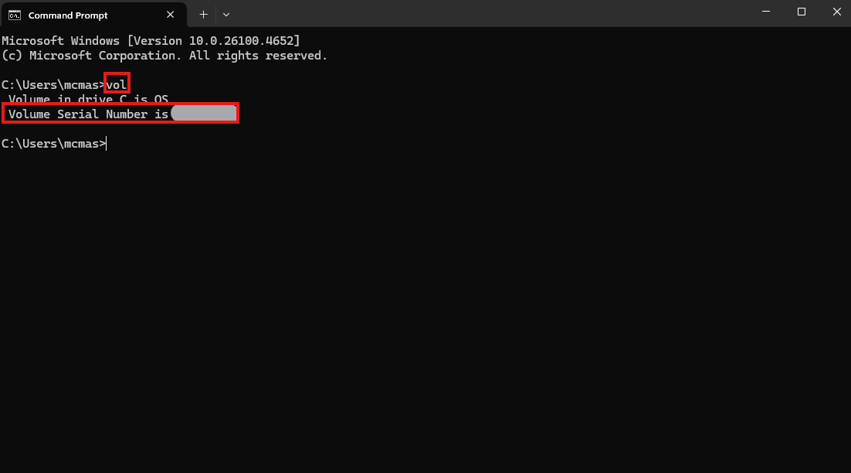
Installation Guide to Model-Based Design Toolbox S32K3xx Series
Installation Steps : Generate and Activate NXP MBDT for S32K3xx license
32. To find the host ID for your hard drive, please open a Windows Command Prompt and execute the vol command.

Slide 36
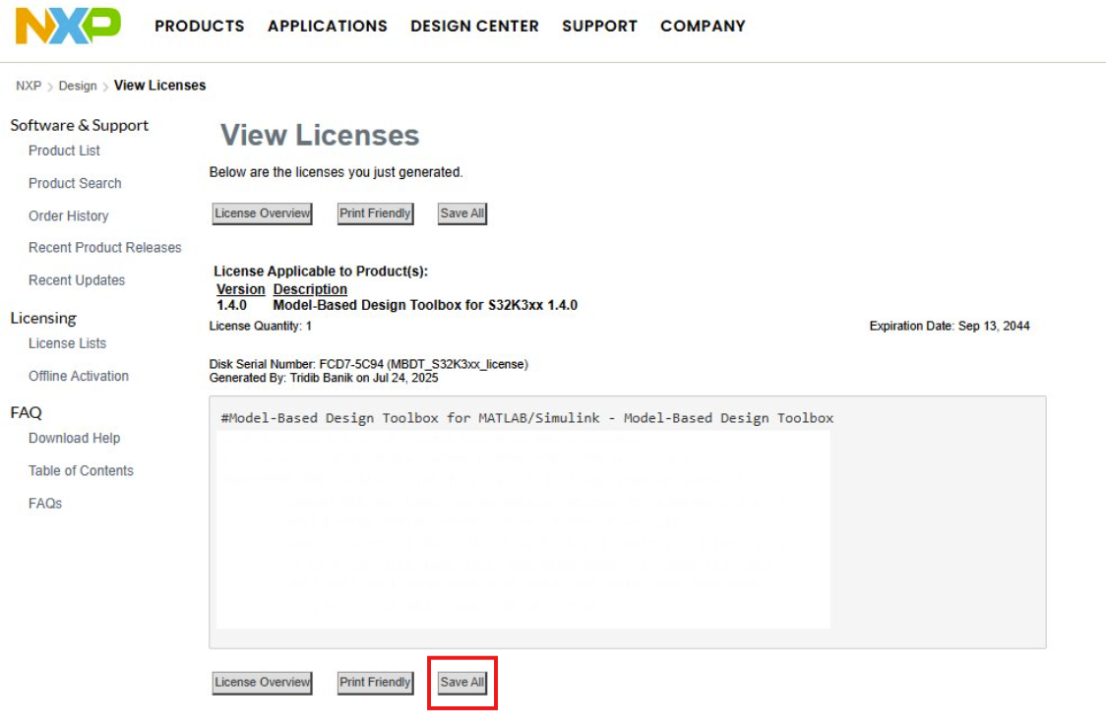
Installation Guide to Model-Based Design Toolbox S32K3xx Series
Installation Steps : Generate and Activate NXP MBDT for S32K3xx license
33. Now that the license has been successfully generated, press the Save All button. Save it in your computer. Remember where you save, you will need to find it later.

Slide 37
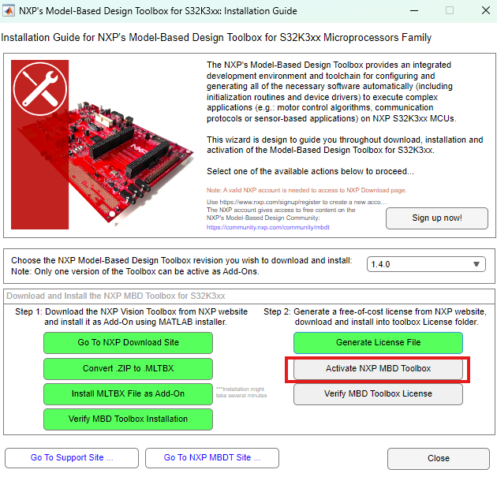
Installation Guide to Model-Based Design Toolbox S32K3xx Series
Installation Steps : Generate and Activate NXP MBDT for S32K3xx license
34. Back to NXP Support Package for S32K3xx, press the Activate NXP MBD Toolbox button.

Slide 38
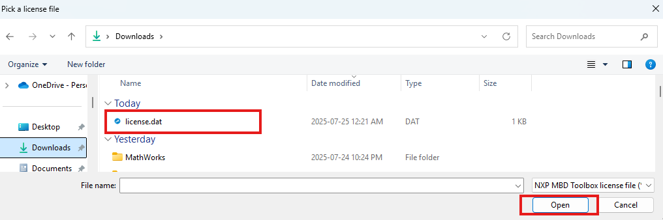
Installation Guide to Model-Based Design Toolbox S32K3xx Series
Installation Steps : Generate and Activate NXP MBDT for S32K3xx license
35. In the newly opened window, Browse for the downloaded license.dat or license.lic file, and press Open.

Slide 39
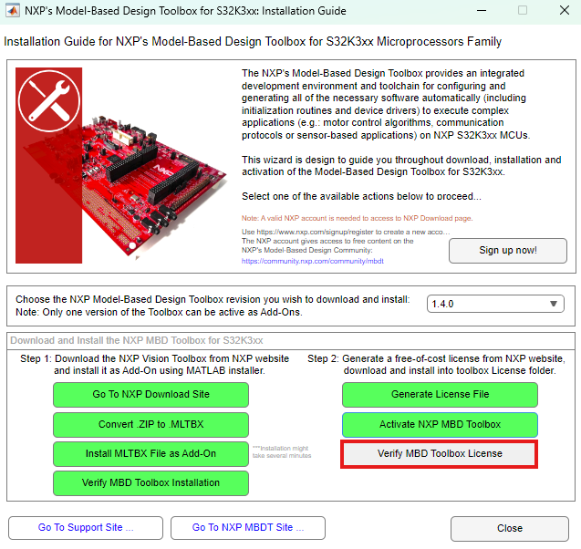
Installation Guide to Model-Based Design Toolbox S32K3xx Series
Installation Steps : Generate and Activate NXP MBDT for S32K3xx license
36. Final step is to check the license activation status, by pressing the Verify MBD Toolbox License button.

Slide 40
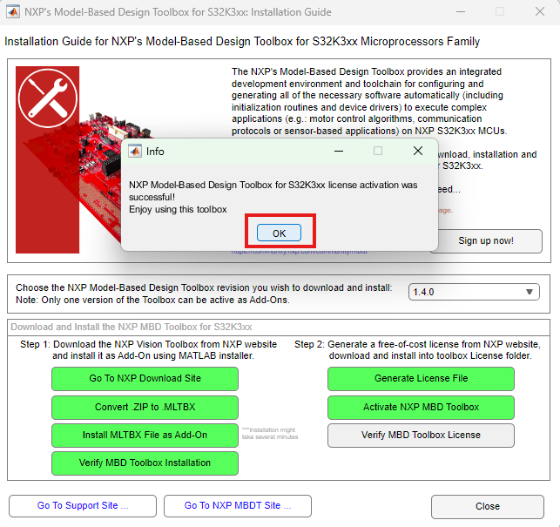
Installation Guide to Model-Based Design Toolbox S32K3xx Series
Installation Steps : Generate and Activate NXP MBDT for S32K3xx license
37. If everything went well, a similar popup window as below will be displayed. Press OK. Then you may close the NXP Support Package for S32K3xx window.

Slide 41
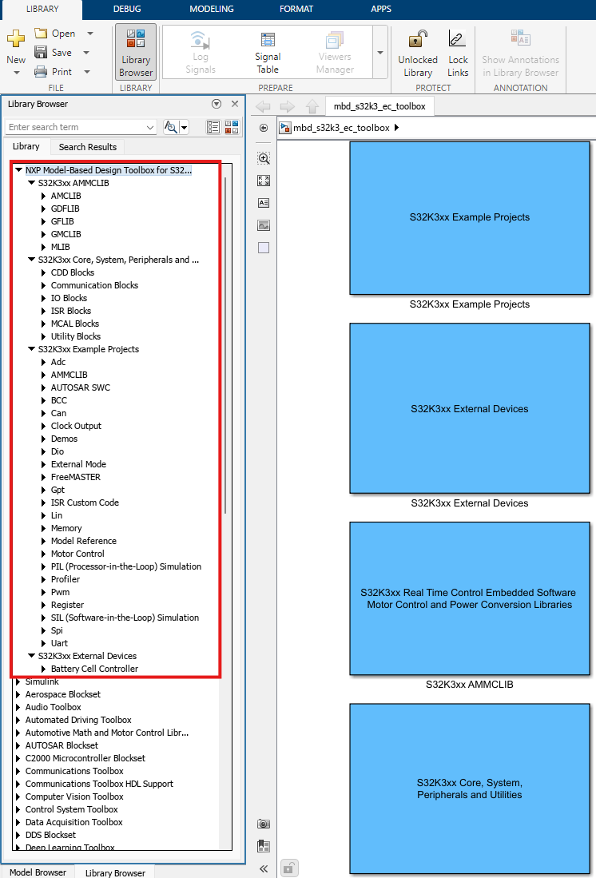
Installation Guide to Model-Based Design Toolbox S32K3xx Series
NXP’s Model-Based Design Toolbox layout and Simulink Library are shown on the right.

Slide 42
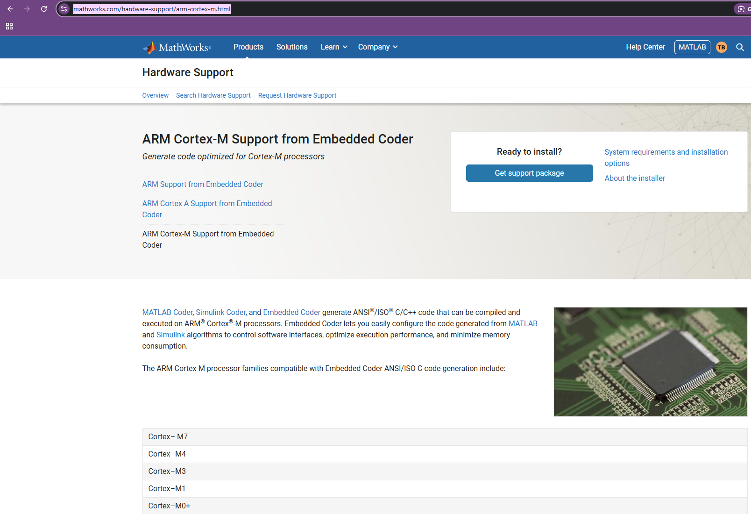
Installation Guide to Model-Based Design Toolbox S32K3xx Series
Installation Steps : Embedded Coder Support Package for ARM CortexM Processor
To enable automatic code generation with Embedded Coder toolbox, users require to install the Embedded Coder Support Package for ARM CortexM Processor as a prerequisite. To install it, go to https://www.mathworks.com/hardware-support/arm-cortex-m.html

Slide 43
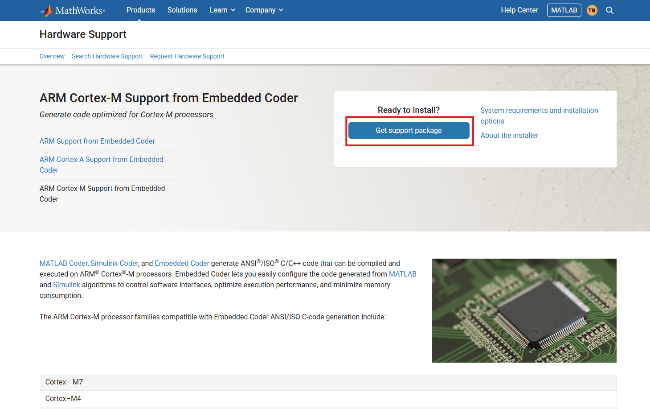
Installation Guide to Model-Based Design Toolbox S32K3xx Series
Installation Steps : Embedded Coder Support Package for ARM CortexM Processor
Press Get Support Package.

Slide 44
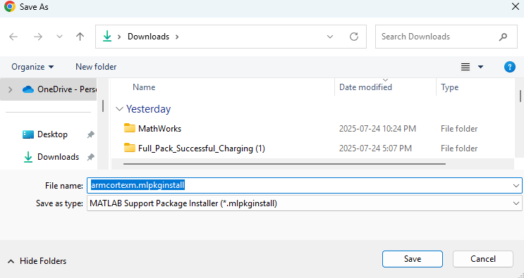
Installation Guide to Model-Based Design Toolbox S32K3xx Series
Installation Steps : Embedded Coder Support Package for ARM CortexM Processor
Save the armcortexm.mlpkginstall file.

Slide 45
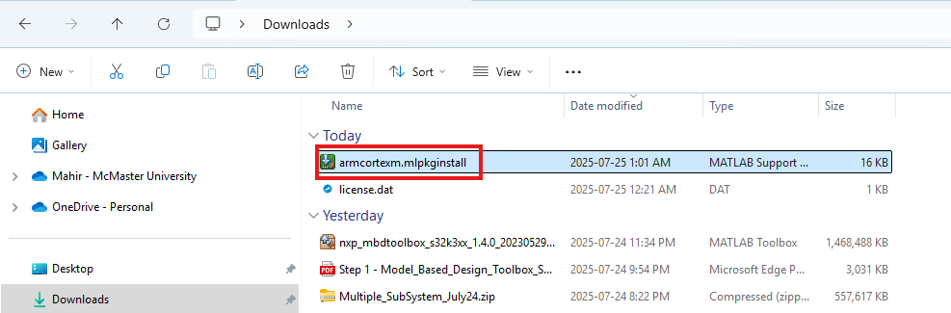
Installation Guide to Model-Based Design Toolbox S32K3xx Series
Installation Steps : Embedded Coder Support Package for ARM CortexM Processor
Execute the file by double-clicking it. It will automatically open an Add-on Manager pop-up window.

Slide 46
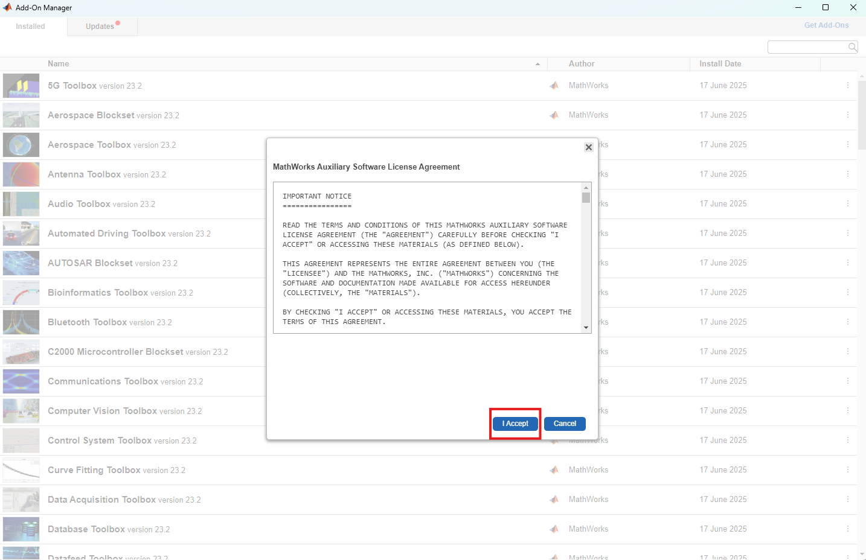
Installation Guide to Model-Based Design Toolbox S32K3xx Series
Installation Steps : Embedded Coder Support Package for ARM CortexM Processor
Press I Accept.

Slide 47
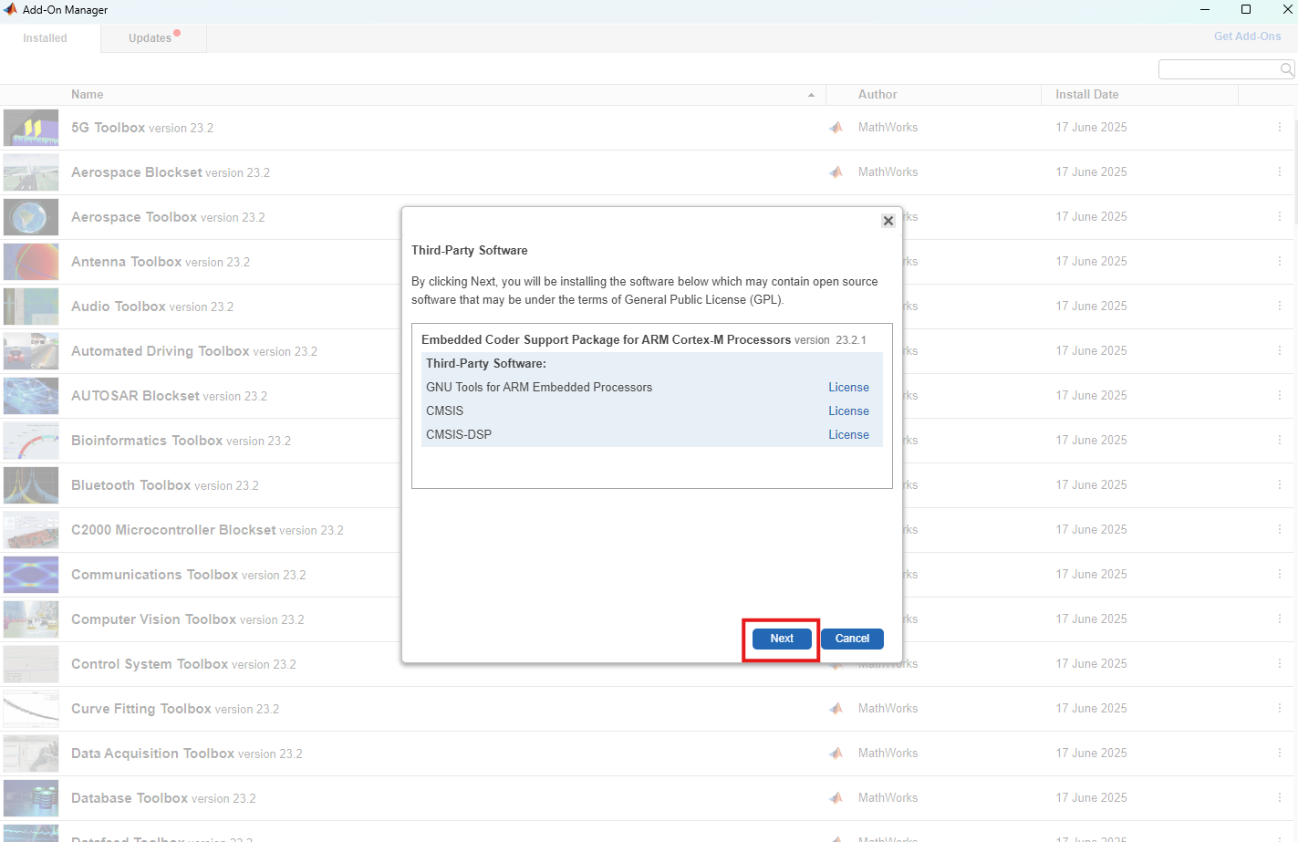
Installation Guide to Model-Based Design Toolbox S32K3xx Series
Installation Steps : Embedded Coder Support Package for ARM CortexM Processor
Press Next.

Slide 48
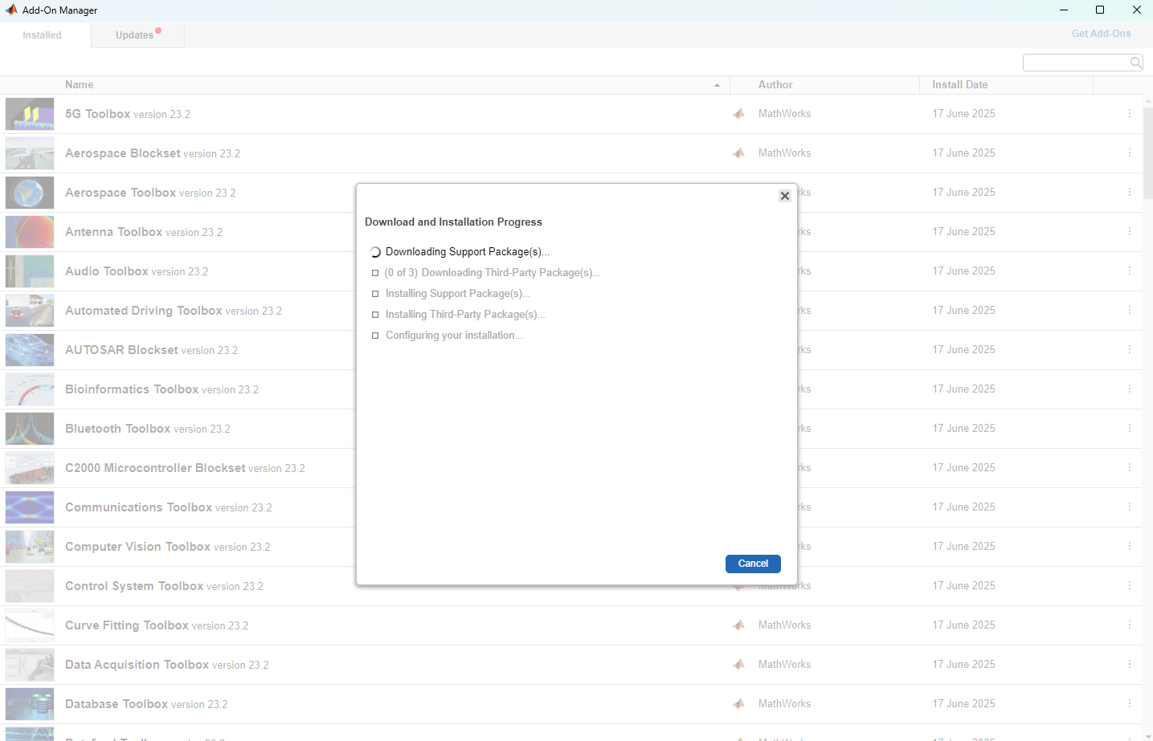
Installation Guide to Model-Based Design Toolbox S32K3xx Series
Installation Steps : Embedded Coder Support Package for ARM CortexM Processor
The download and installation process may take a few minutes.

Slide 49
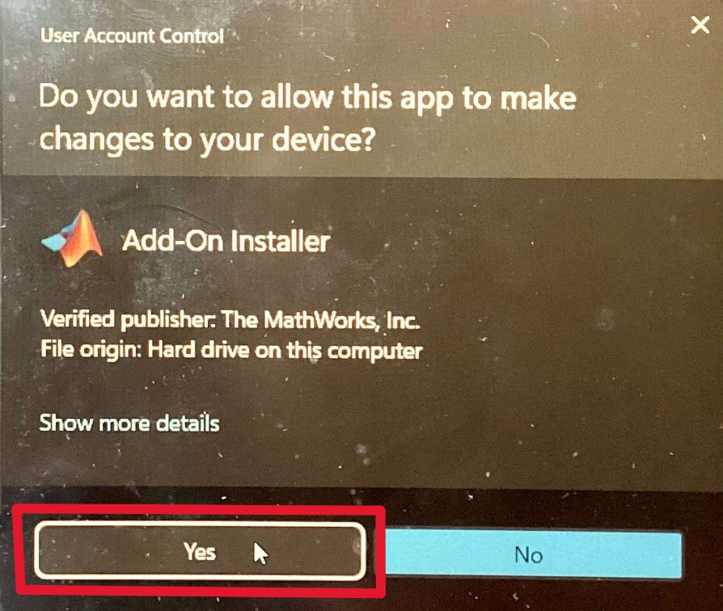
Installation Guide to Model-Based Design Toolbox S32K3xx Series
Installation Steps : Embedded Coder Support Package for ARM CortexM Processor
In the pop-up window of “Do you want to allow this app to make changes to your device?”, press yes.

Slide 50
Installation Guide to Model-Based Design Toolbox S32K3xx Series
Installation Steps : Embedded Coder Support Package for ARM CortexM Processor
The download and installation process may take a few minutes.

Slide 51
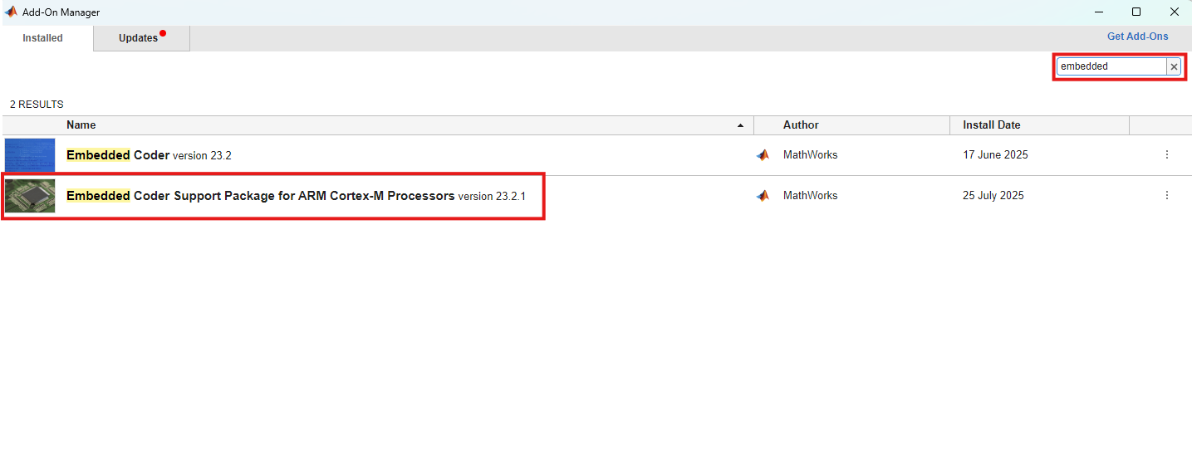
Installation Guide to Model-Based Design Toolbox S32K3xx Series
Installation Steps : Embedded Coder Support Package for ARM CortexM Processor
After the installation is complete, you can verify it by searching for the package.

Slide 52
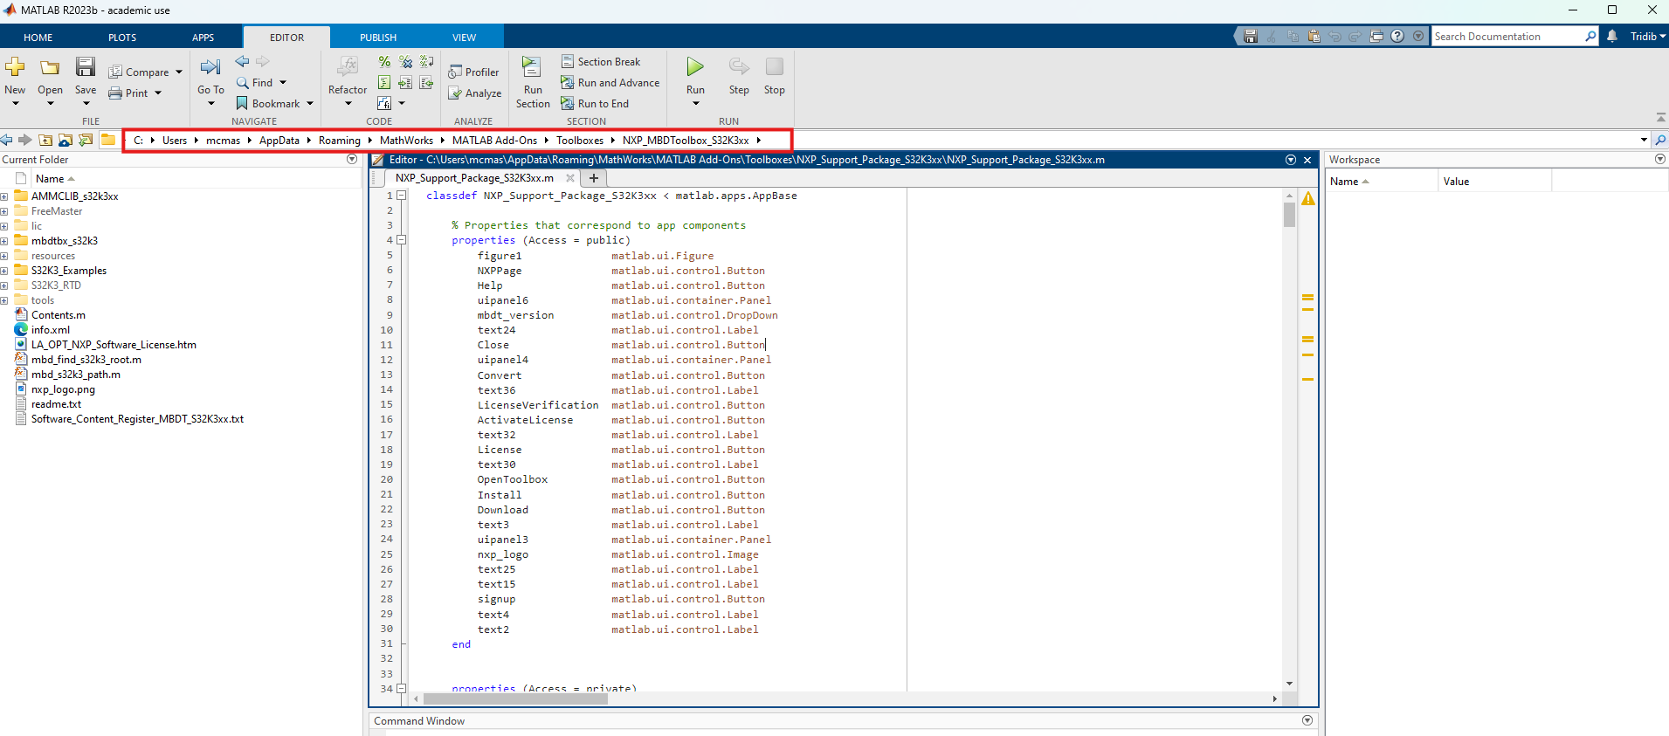
Installation Guide to Model-Based Design Toolbox S32K3xx Series
Setting the Path for Model-Based Design Toolbox and Toolchain Generation
For path setup, first go to the NXP Model Toolbox installation directory, i.e., C:\Users\xxxxx\AppData\Roaming\MathWorks\MATLAB Add-Ons\Toolboxes\NXP_MBDToolbox_S32K3xx

Slide 53
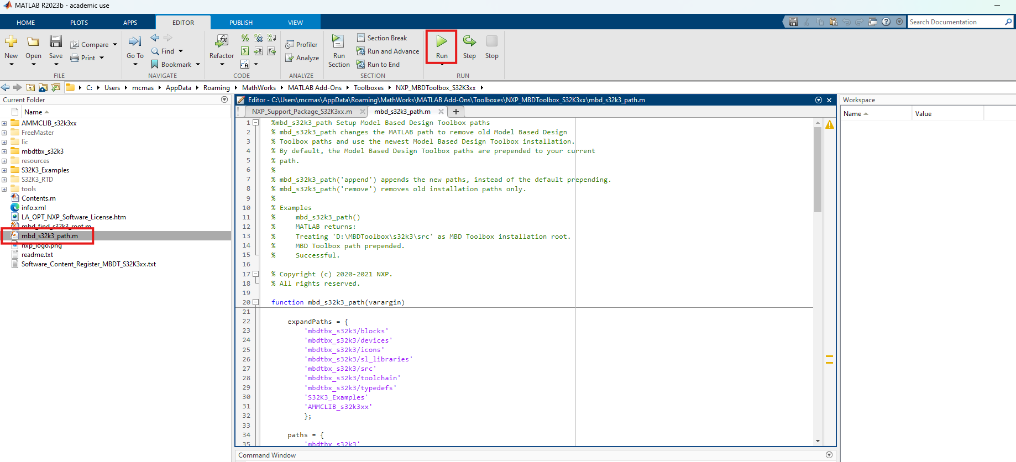
Installation Guide to Model-Based Design Toolbox S32K3xx Series
Setting the Path for Model-Based Design Toolbox and Toolchain Generation
Next, run mbd_s32k3_path.m script.

Slide 54
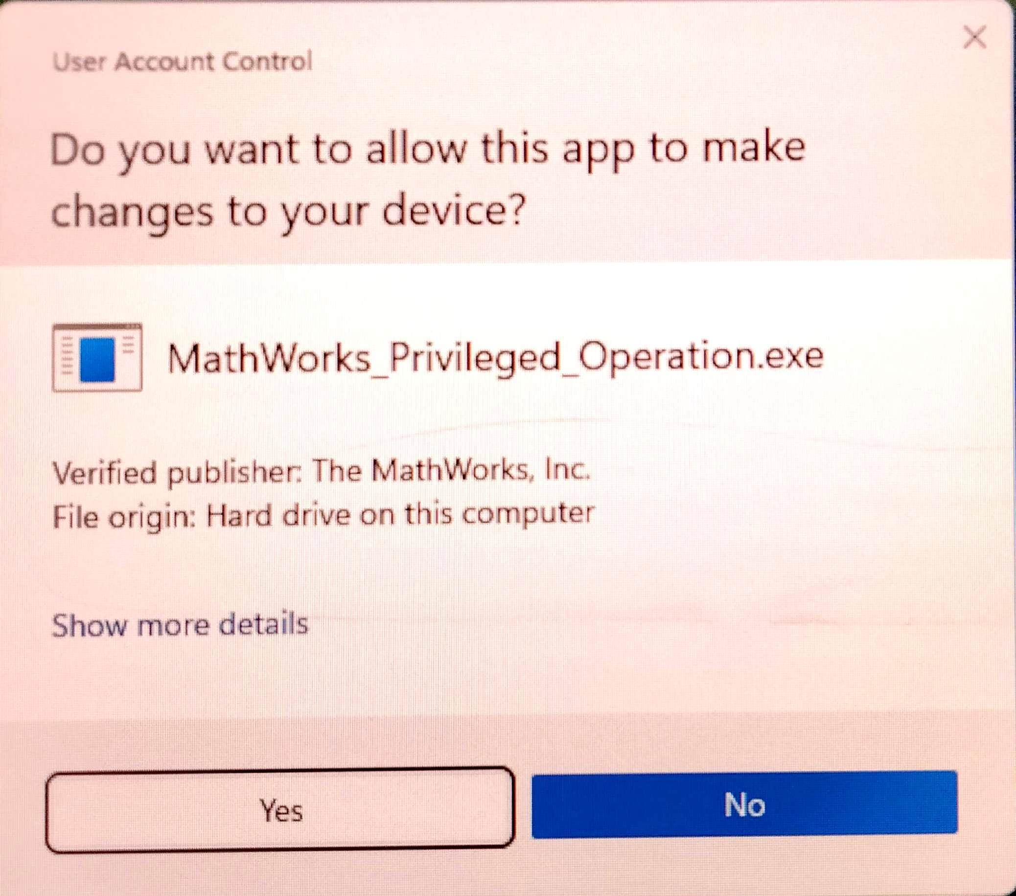
Installation Guide to Model-Based Design Toolbox S32K3xx Series
Setting the Path for Model-Based Design Toolbox and Toolchain Generation
In the pop-up window of “Do you want to allow this app to make changes to your device?”, press yes.

Slide 55

Installation Guide to Model-Based Design Toolbox S32K3xx Series
Setting the Path for Model-Based Design Toolbox and Toolchain Generation
The Command Window output for a successful setup should look like below. It may take a few minutes.
The mbd_s32k3_path.m script, you just finished running, verifies the user setup dependencies and will issue instructions for a successful installation and configuration of the toolbox.

Slide 56
Thank you
McMaster Automotive Resource Centre (MARC)
56

